Slide 1
Windows Messaging
Dong JIA
Agilent VEE Team

Slide 2
Agenda
Basic concept
Thread ownership
THREADINFO
SendMessage family
PostMessage family
Algorithm for Extracting Messages
Hardware Input Model
Local Input State
References

Slide 3
Basic concept
WndProc
WNDCLAS
MSG

Slide 4
Thread ownership
A single process can create up to 10,000 different types of User objects
  Icons, cursors, window classes, menus, accelerator tables, and more.
  These objects are owned by the process
  Without a thread explicitly destroying the object, the OS will automatically destroy the object

Slide 5
Thread ownership
Two User objects - windows and hooks - are owned by the thread that creates the window or installs the hook.
  The thread that creates a window must be the thread that handles all messages for the window.
  Every thread that creates at least one window is assigned a message queue by the system. This queue is used for window message dispatching.

Slide 6
THREADINFO
THREADINFO
  make the thread think that it is running in its very own environment.
  is an internal, undocumented data structure that identifies the thread's
    posted-message queue
    send-message queue
    reply- message queue
    virtualized-input queue
    wake flags
    a number of variables that are used for the thread's local input state.

Slide 7
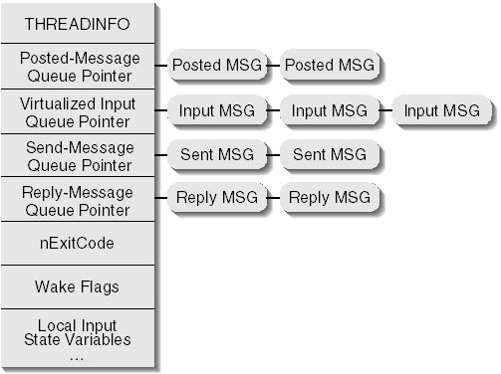
THREADINFO

Slide 8
THREADINFO
Incoming send messages are delivered directly to the window procedure.
Posted messages and Input message are retrieved (if GetMessage or PeekMessage).
Can’t simulate input with the PostMessage function

Slide 9
SendMessage family
sender and receiver are on the same thread
  the window procedure of the receiver is called directly
sender and receiver are on different threads
  the message is added to the incoming sent messages of the receiver, and the receiver is "woken" to process the incoming message
Including:
  SendMessage
  SendNotifyMessage
  SendMessageCallback
  SendMessageTimeout

Slide 10
PostMessage family
add the message to the posted messages and wake the receiver.
Including:
  PostMessage
  PostThreadMessage
SendInput is similar with PostMessage

Slide 11
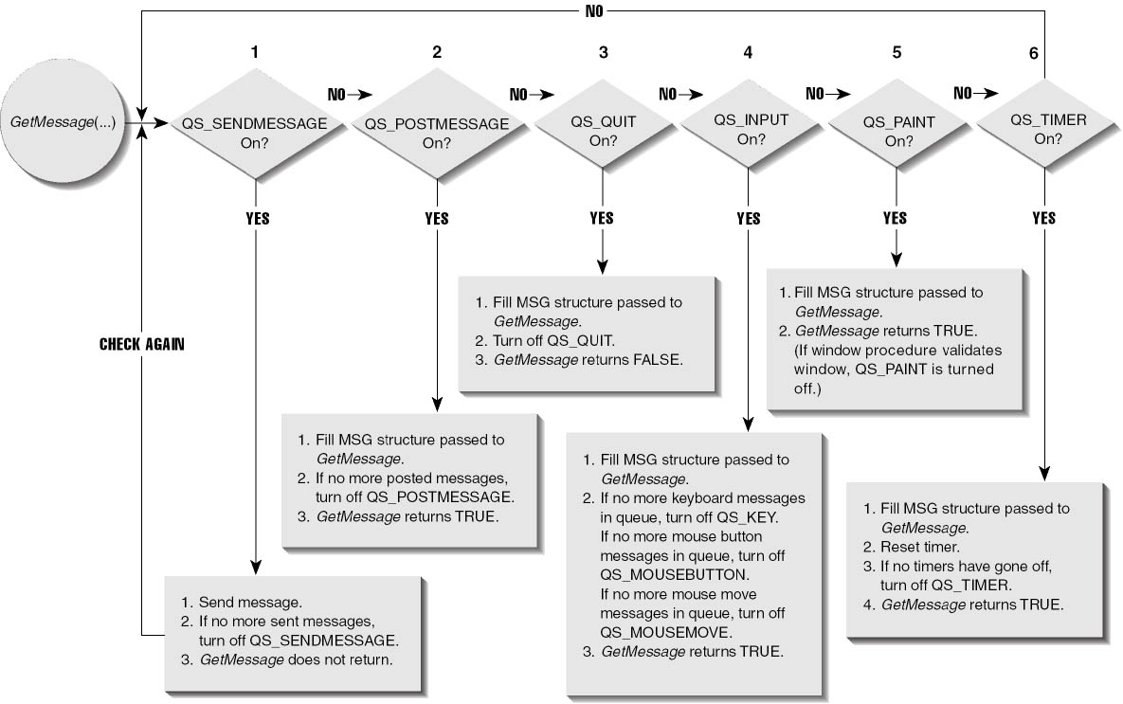
Algorithm for Extracting Messages

Slide 12
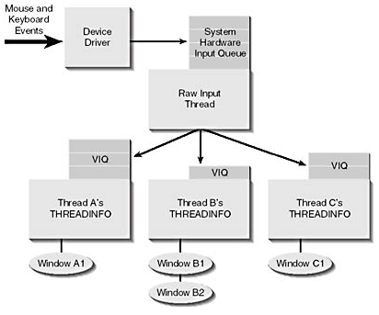
Hardware Input Model

Slide 13
Hardware Input Model
how does the RIT know which thread's VIQ to append the hardware input messages to?
  For mouse messages, the RIT simply determines which window is under the mouse cursor.
  For keystroke hardware events, at any given time, one thread is "connected" to the RIT. This thread is called the foreground thread.

Slide 14
Local Input State
Each thread has its own local input state inside a thread's THREADINFO structure
consists of the thread's virtualized input queue as well as a set of variables.
Keyboard input and window focus information, such as
  Which window has keyboard focus
  Which window is active
  Which keys are considered pressed down
  The state of the caret
mouse cursor management information, such as
  Which window has mouse capture
  The shape of the mouse cursor
  The visibility of the mouse cursor

Slide 15
Reference
Programming Applications for Microsoft Windows, Jeffrey Richter
Window via C++, Jeffrey Richter
Programming Windows, Charles Petzold
The old new thing, Raymod Chen

Slide 16
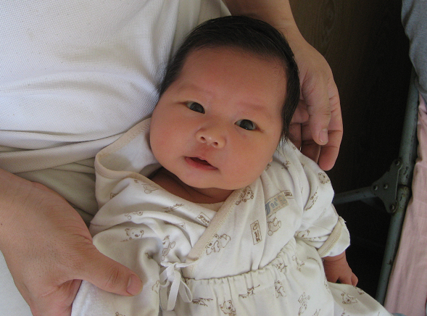
Q&A

Slide 17
THANKS

